Slide 1
LINUX
Linux
gdfdgdfdhfhfjdfhjgfhgfgjdfhgjdhffkkfjgkfj

Slide 2
Introduction to Linux

Slide 3
Background
Version of UNIX
Linus Torvalds – Creator of Linux
Free Software
Open Source Operating System
Source Code Available

Slide 4
How is Linux Used?
Personal Workstation
File and Print Server
Internet Service Provider
Webhosting
Mail servers

Slide 5
Linux Distributions
Red Hat
Corel Linux
Debian GNU/Linux
OpenLinux (Caldera)
Slackware
SuSE
TurboLinux

Slide 6
Why Use Linux?
Costs less
Stable
Reliable
Extremely powerful

Slide 7
Linux Architecture
Notes:
9/25/20089/11/2008
7
9/11/2008
7
7

Slide 8
UNIX/LINUX Architecture
Applications
cp
mkdir
Kernel
tar
which
HTTP
FTP
Hardware
fdisk
service
shell
DBMS
Notes:
9/25/20089/11/2008
8
9/11/2008
8
8

Slide 9
UNIX/LINUX Architecture
CPU
RAM
Hard disks
Monitor
Keyboard
Hardware
Notes:
9/25/20089/11/2008
9
9/11/2008
9
9

Slide 10
UNIX/LINUX Architecture
Kernel
Hardware
Kernel interacts with all your hardware device using low level instructions
Kernel uses device drivers to talk to different types of devices
Notes:
9/25/20089/11/2008
10
9/11/2008
10
10

Slide 11
UNIX/LINUX Architecture
cp
mkdir
Kernel
tar
which
Hardware
fdisk
service
bash
Shell is the interface for user to interact with system
Shell accepts the commands from user, interprets them and passes them to kernel for execution
Notes:
9/25/20089/11/2008
11
9/11/2008
11
11

Slide 12
UNIX/LINUX Architecture
Applications
cp
mkdir
Kernel
tar
which
HTTP
FTP
Hardware
fdisk
service
shell
DBMS
Notes:
9/25/20089/11/2008
12
9/11/2008
12
12

Slide 13
Shell

Slide 14
What is a “Shell”?
The “Shell” is simply another program on top of the kernel which provides a basic human-OS interface.
It is a command interpreter
Built on top of the kernel
Enables users to run services provided by the UNIX OS
In its simplest form, a series of commands in a file is a shell program that saves having to retype commands to perform common tasks.
How to know what shell you use
echo $SHELL

Slide 15
UNIX Shells
sh Bourne Shell (Original Shell) (Steven Bourne of AT&T)
bash Bourne Again Shell (GNU Improved Bourne Shell)
csh C-Shell (C-like Syntax)(Bill Joy of Univ. of California)
ksh Korn-Shell (Bourne+some C-shell)(David Korn of AT&T)
tcsh Turbo C-Shell (More User Friendly C-Shell).
Notes:
9/25/20089/11/2008
15
9/11/2008
15
15

Slide 16
Default Shell
On many systems such as our LINUX sh is symbolically linked to bash
/bin/sh -> /bin/bash
All Linux versions use the Bash shell (Bourne Again Shell) as the default shell
Bash/Bourn/ksh/sh prompt: $
All UNIX system include C shell and its predecessor Bourne shell.
Csh/tcsh prompt: %

Slide 17
Using Shell
To check shell:
$ echo $SHELL (SHELL is a pre-defined variable)
To switch shell:
$ exec shellname (e.g., exec bash or simply type bash)
You can switch from one shell to another by just typing the name of the shell.
exit return you back to previous shell.
Notes:
9/25/20089/11/2008
17
9/11/2008
17
17

Slide 18
Bash advantages
Tab completion
History
Aliases
Environment variables
Functions
Shortcuts
Programming capabilities

Slide 19
Shortcuts
Ctrl + r # Match the pattern in the command history
Alt + . # Show the last word from the previous command
Ctrl + d # Exist from the current shell
Ctrl + A # Moves the cursor to the starting of the command
Ctrl + E # Moves the cursor to the end of the command
Ctrl + u # Deletes the command from the current cursor position to the starting
Ctrl + k # Deletes the command from the current cursor to the end of the command

Slide 20
Commands

Slide 21
Linux command syntax
command [<options1><option2>…….] [<argument1> <argument2> …. ]
Ex: ls –l (Command with only one option)
ls –a –l (Command with two options)
ls –al (Command with two options combined)
ls –al /var (Command with combined options and one argument)
ls –al /var /tmp (Command with combined options and two arguments)
Notes:
9/25/20089/11/2008
21
9/11/2008
21
21

Slide 22
File and Directory Management
ls List contents of a directory.
Ex: ls, ls –l , ls –al, ls –ld, ls –R
touch Change file timestamps to the current time. Make the file if it doesn't exist.
Ex: touch <filename>
cat Displays the file contents
Ex: cat filename.txt
tac Displays the file contents in reverse order
Ex: tac filename.txt
Notes:
9/25/20089/11/2008
22
9/11/2008
22
22

Slide 23
File and Directory Management
cp Copy a file from one location to another.
Ex: cp file1 file2 Copy file1 to file2;
Ex: cp –R dir1 dir2 : Copy dir1 to dir2
mv Move or rename a file or directory.
Ex: mv <source> <destination>
echo prints the argument on the screen
Ex: echo “hello world”
printf Prints the argument in given format
Ex: printf “hello world” ( new line character is not added by default)
Notes:
9/25/20089/11/2008
23
9/11/2008
23
23

Slide 24
File and Directory Management
mkdir Make a directory.
Ex: mkdir <directory name> : Makes a directory
Ex mkdir –p /www/chache/var/log will create all the directories recursively
pwd Print or list the present working directory with full path.
cd Change the current directory. With no arguments "cd" changes to the users home directory. (cd <directory path>)
rm Delete files (Remove files). (rm –rf <directory/file>)
rmdir Removes a directory.
The directory must be empty. (rmdir <directory>)
Use rm –r to remove the directory recursively
Notes:
9/25/20089/11/2008
24
9/11/2008
24
24

Slide 25
File and Directory Management
tree Displays the contents of the given directory in a tree format
Notes:
9/25/20089/11/2008
25
9/11/2008
25
25

Slide 26
Types of commands
Shell built-ins
Aliases
External commands

Slide 27
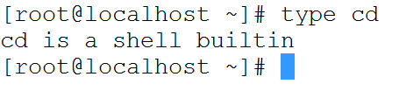
Shell built-ins
Part of your shell
Different from shell to shell
cd, pwd, umask etc..
type <command> will tell you if it is shell built-in

Slide 28
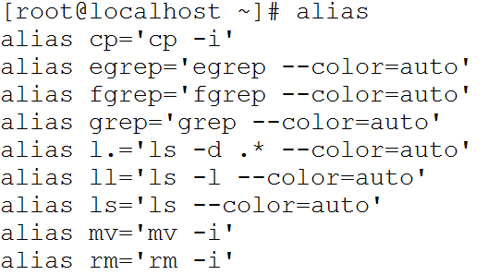
Aliases
Created by users
aliases command displays all the existing aliases

Slide 29

External commands
Other commands available from different packages
ls, mkdir, ifconfig, hostname etc..

Slide 30
Comparing file contents
cmp Compares the data in the files
diff Finds the differences in the files
join Joins the files contents line by line
paste paste the contents side by side
cut Cuts and display the files of the file by the give delimiter
sort Sort a file alphabetically.
uniq Remove duplicate lines from a sorted file.
Notes:
9/25/20089/11/2008
30
9/11/2008
30
30

Slide 31
Searching files/content of the files
grep Searches for the given pattern in the files.
Ex : grep <string> <filename>
grep hello goodbye.txt
find Find files (find <start directory> -name <file name> -print)
Ex: find /home –name readme -print
Search for readme starting at home and output full path, “/home" = Search starting at the home directory and proceed through all its subdirectories; "-name readme" = Search for a file named readme "-print" = Output the full path to that file
locate File locating program that uses the slocate database.
Ex: locate –u to create the database,
locate <file/directory> to find file/directory
Notes:
9/25/20089/11/2008
31
9/11/2008
31
31

Slide 32
Compress
gzip zip a file to a gz file.
gunzip unzip a gz file.
zip Compresses a file to a .zip file.
unzip Uncompresses a file with .zip extension.
bzip2 Compress using bzip2
bunzip2 Uncompress using bunzip2
Notes:
9/25/20089/11/2008
32
9/11/2008
32
32

Slide 33
Archive
tar Archives files and directories. Can store files and directories on tapes.
Ex: tar -zcvf <destination> <files/directories> - Archive copy groups of files. tar –zxvf <compressed file> to uncompress
cpio Can store files on tapes. to/from archives.
Notes:
9/25/20089/11/2008
33
9/11/2008
33
33

Slide 34
Getting help from system

Slide 35
Help commands
apropos To quickly search the available commands for a specific task
man To understand the working of the command and possible options use
info Using the GNU Info System
whereis Locate the binary and man page files for a command. (whereis <program/command>)
which Show full path of commands where given commands reside. (which <command>)
Many tools have a long−style option, `−−help', that outputs usage information about the tool, including the options and arguments the tool takes. Ex: whoami --help
Notes:
9/25/20089/11/2008
35
9/11/2008
35
35

Slide 36
man sections
1 Executable programs or shell commands
2 System calls (functions provided by the kernel)
3 Library calls (functions within program libraries)
4 Special files (usually found in /dev)
5 File formats and conventions eg /etc/passwd
6 Games
7 Miscellaneous (including macro packages and conventions), e.g. man(7), groff(7)
8 System administration commands (usually only for root)
9 Kernel routines [Non standard]
Notes:
9/25/20089/11/2008
36
9/11/2008
36
36

Slide 37
Exit status
0-255
0 successful
1-255 error
echo $? Displays the exit status of the previous command
Notes:
9/25/20089/11/2008
37
9/11/2008
37
37

Slide 38
System management commands
date Display or change the system date.
Ex: date, date –s “oct 20”
date +%d to display only todays’ date
date +%m to display only the current month
cal displays the current month from the calendar
who See who logged into the system
w See who logged into the system and what are they doing currently with some advanced options.
printf Print the statements with nice formatting.
exit Exit from the shell.
Notes:
9/25/20089/11/2008
38
9/11/2008
38
38

Slide 39
System management commands
uptime displays how long the system has been running
cat /proc/cpuinfo displays the process information
free displays RAM available and used on the system
df displays the available partitions and their sizes
fdisk displays or manipulate disk partition table
ifconfig displays network information of the system
ps displays the process running by the current user
ps -ef displays all the process running
Notes:
9/25/20089/11/2008
39
9/11/2008
39
39

Slide 40
System management commands
top monitors the processes running on systems
route prints routing table information
Notes:
9/25/20089/11/2008
40
9/11/2008
40
40

Slide 41
Performing calculations
$(( )) Perform arithmetic expressions
Ex: echo $((4+5)) prints 9
wc Counts the number of lines in a file
bc Basic calculator
Ex: echo 4+5 | bc prints 9
expr Perform any calculations
let
Notes:
9/25/20089/11/2008
41
9/11/2008
41
41

Slide 42
Network Commands

Slide 43
Network Commands
ping Checks if the remote server is responding
nslookup query Internet name servers interactively
traceroute
tcpdump
iptables
firewall-cmd
Notes:
9/25/20089/11/2008
43
9/11/2008
43
43

Slide 44
Network Commands
ssh Login to remote server using ssh protocol
scp Upload or download files from remote machines
sftp Upload or download files from remote machines. Has many other advantages over scp
telnet login to remote servers using telnet protocol or checks the remote service connectivity
ftp Login to remote server using ftp protocol
Notes:
9/25/20089/11/2008
44
9/11/2008
44
44

Slide 45
File Types

Slide 46
Anything is a file
File
Directory
Hard disk
Printer

Slide 47
File Types
Files -
Directories d
Links l
Block devices b
Character devices c
Pipes p
Sockets s

Slide 48
Device Types
Character devices
Block devices
Pseudo-devices

Slide 49
Character devices
Character special files or character devices provide unbuffered, direct access to the hardware device.
They do not necessarily allow you to read or write single characters at a time; that is up to the device in question.
Examples
Monitor
Keyboard
Printer

Slide 50
Block devices
Block special files or block devices provide buffered access to the hardware
Examples
Hard disk

Slide 51
Pseudo devices
Device nodes on Unix-like systems do not necessarily have to correspond to physical devices
They provide various functions handled by the operating system.
Examples
/dev/null
/dev/random
/dev/zero

Slide 52
Regular Expressions

Slide 53
Regular expressions
. Matches any single character.
? The preceding item is optional and will be matched, at most, once.
* The preceding item will be matched zero or more times.
+ The preceding item will be matched one or more times.
{N} The preceding item is matched exactly N times.
{N,} The preceding item is matched N or more times.
{N,M} The preceding item is matched at least N times, but not more than M times.
Notes:
9/25/20089/11/2008
53
9/11/2008
53
53

Slide 54
Regular expressions
represents the range if it's not first or last in a list or the ending point of a range in a list.
^ Matches the empty string at the beginning of a line; also represents the characters not in the range of a list.
$ Matches the empty string at the end of a line.
\b Matches the empty string at the edge of a word.
\B Matches the empty string provided it's not at the edge of a word.
\< Match the empty string at the beginning of word.
\> Match the empty string at the end of word.
Notes:
9/25/20089/11/2008
54
9/11/2008
54
54

Slide 55
Regular expressions
Examples
Notes:
9/25/20089/11/2008
55
9/11/2008
55
55

Slide 56
VI Editor

Slide 57
File editors
vi Editor with a command mode and text mode. Starts in command mode.
Nano
emacs Full screen editor.
pico Simple text editor.
gedit GUI Text Editor
gvim GUI for VI editor
Notes:
9/25/20089/11/2008
57
9/11/2008
57
57

Slide 58
VI Modes
Escape mode
Insert mode
Command mode
Notes:
9/25/20089/11/2008
58
9/11/2008
58
58

Slide 59
VI commands ( Escape mode )
h Move cursor to left one position
j Move cursor to one line down
k Move cursor to one line up
l Move cursor to right one position
b Move to the beginning of the current word
e Move to the end of the current word
w Move to the beginning of the next word
f<char> Move to the matching character in the current line in forward direction
F<char> Move to the matching character in the current line in reverse direction
Notes:
9/25/20089/11/2008
59
9/11/2008
59
59

Slide 60
VI commands ( Escape mode )
gg Takes to the first line of the file
G Takes to the last line of the file
^ Takes to the starting of the current line
$ Takes to the end of the current line
H Takes to the starting of the current screen
M Takes to the middle f the current screen
L Takes to the last of the current screen
Notes:
9/25/20089/11/2008
60
9/11/2008
60
60

Slide 61
VI commands ( Escape mode )
dd delete the current line
yy copy the current line
p paste the content below the current line
P(capital) paste the content above the current line
i Enter into insert mode from the current cursor position
I Enter into insert mode and move the cursor to the beginning of the current line
a Enter into insert mode from the next character position
A Enter into insert mode and move the cursor to the end of the current line
Notes:
9/25/20089/11/2008
61
9/11/2008
61
61

Slide 62
VI commands ( Escape mode )
dw deletes the current word
dl deletes the current character
yw copies the current word
yl copies the current character
Prefixing a number before the command would execute the command given number of times
2dd deletes 2 lines from current position
2dw deletes 2 words from current position
2yw copies 2 lines from current cursor position
2p pastes the content in buffer 2 times below/after the cursor position
Notes:
9/25/20089/11/2008
62
9/11/2008
62
62

Slide 63
VI commands ( Escape mode )
/<pattern> Perform search for the given pattern in forward direction
?<pattern> Perform search for the given pattern in reverse direction
n Finds the next pattern in forward direction
N Finds the next pattern in reverse direction
Notes:
9/25/20089/11/2008
63
9/11/2008
63
63

Slide 64
VI commands ( Command mode )
q Quit or Exit
q! Quit without saving the changes
wq / x Save the changes and Quit
w Save the changes
w <file> Save the change with file name
r <file> Paste the content of the file below the current line
sp <file> Open file in a tab
next Read next file
prev Read previous file
help Show help message
Notes:
9/25/20089/11/2008
64
9/11/2008
64
64

Slide 65
VI preferences
set nu #Display line numbers
set ai #auto indentation in programming
set ts=4 # set tab space to 4 rather than default 8
Notes:
9/25/20089/11/2008
65
9/11/2008
65
65
execute this from command mode
:set nu
:set ts=4

Slide 66
Filters

Slide 67
Pagers/Filters
head displays the top of the file
tail displays the bottom of the file
more Displays the file content page wise
less
Display the file content page wise.
Advanced version of more command.
Supports searching and browsing the file.
Notes:
9/25/20089/11/2008
67
9/11/2008
67
67

Slide 68
Pagers/Filters
awk an extremely versatile programming language for working on files
sed stream editor, extremely powerful!
Notes:
9/25/20089/11/2008
68
9/11/2008
68
68

Slide 69
Pagers/Filters ( Examples )
head /etc/passwd displays first lines by default of /etc/passwd
head -n 20 /etc/passwd displays first 20 lines of /etc/passwd
tail /etc/passwd displays last10 lines by default of /etc/passwd
tail -n 20 /etc/passwd displays last 20 lines of /etc/passwd
tail -f /var/log/messages displays the file in active mode (Ctrl+C to cancel )
Notes:
9/25/20089/11/2008
69
9/11/2008
69
69

Slide 70
Pagers/Filters ( Examples )
more /var/log/messages
Enter to scroll down by one line
Space to scroll down by page wise
q to quit
less /var/log/messages
Enter to scroll down by one line
Space to scroll down by page wise
/<pattern> to search any pattern
q to quit
Notes:
9/25/20089/11/2008
70
9/11/2008
70
70

Slide 71
Pagers/Filters ( Examples )
awk -F: '{ print $1 }' /etc/passwd
Displays the first field (usernames) from /etc/passwd
awk -F: '{ print $1 }' /etc/passwd
Displays the third field (user ids) from /etc/passwd
awk -F: '{ if ( $3 > 100 ) print $1 }' /etc/passwd
Displays the user ids only when they are grater than 100 from /etc/passwd
Notes:
9/25/20089/11/2008
71
9/11/2008
71
71

Slide 72
Pagers/Filters ( Examples )
sed ‘1d’ /etc/passwd Remove line 1 from /etc/passwd and print the remaining file
sed ‘1,10d’ /etc/passwd Remove lines 1 to 10 from /etc/passwd and print the remaining file
sed -n '1,10p' /etc/passwd Prints lines from 1 to 10 . same as head.
sed -n '15,$p' /etc/passwd Prints lines from 15 till end of file 10
sed –e ‘s/root/ROOT/’ /etc/passwd Replace root with ROOT ( capitals ). Impacts only first occurrence of the file in all lines
sed –e ‘s/root/ROOT/g’ /etc/passwd Replace root with ROOT ( capitals ). Impacts all occurrences of the file in all lines
Notes:
9/25/20089/11/2008
72
9/11/2008
72
72

Slide 73
Pagers/Filters ( Examples )
sed -i ‘1d’ /etc/passwd Remove line 1 from /etc/passwd and print the remaining file.
Effects the original file with option “–i”
Notes:
9/25/20089/11/2008
73
9/11/2008
73
73

Slide 74
Pipes & Redirection

Slide 75
Pipes & Redirection
Standard Input
Standard Output
Standard Error
0
INPUT
env
1
2
OUTPUT
ERROR

Slide 76
Pipes & Redirection
Piping: An important early development in Unix , a way to pass the output of one tool to the input of another.
$ who | wc −l
By combining these two tools, giving the wc command the output of who, you can build a new command to list the number of users currently on the system
Redirecting via angle brackets: Redirecting input and output follows a similar principle to that of piping except that redirects work with files, not commands.
tr '[a-z]' '[A-Z]' < $in_file > $out_file
The command must come first, the in_file is directed in by the less_than sign (<) and the out_file is pointed at by the greater_than sign (>).

Slide 77
Pipes
echo “Hello” | wc -c
INPUT
0
echo
OUTPUT
ERROR
1
2
A Pipe!
INPUT
0
wc
OUTPUT
1
ERROR
2

Slide 78
Redirection
echo “Hello” > file.txt
echo “World” > file.txt
echo “Hello” >> file.txt
0
INPUT
env
1
2
OUTPUT
ERROR
Disk

Slide 79
Redirection
cat > /tmp/myfile
cat >> /tmp/myfile
cat 2> /tmp/myerr
cat < /tmp/myinput
cat <<INPUT Some input INPUT
cat > /tmp/x 2>&1
0
INPUT
env
1
2
OUTPUT
ERROR

Slide 80
Redirection commands
tee Redirect the output to multiple files
Ex : ls | wc | tee count.txt
The count of the files is displayed on screen and also saved to the file count.txt
xargs Process the output of the previous command

Slide 81
Process monitoring

Slide 82
Process vs daemon
Process - Process is a running program. At a particular instant of time, it can be either running,sleeping, or zombie (completed process, but waiting for it's parent process to pick up the return value).
Daemons are recognized by the system as any processes whose parent process has a PID of one, which always represents the process init.
init is always the first process ( sysemd on centos 7 )
starts when a Linux computer is booted up
it remains on the system until the computer is turned off.
init adopts any process whose parent process dies (i.e., terminates) without waiting for the child process's status.
Has process id 1
Notes:
9/25/20089/11/2008
82
9/11/2008
82
82

Slide 83
Process attributes
Process id Each process has a unique id from 1 - 65535
Owner The user created the process
Group The primary group of the user created the process
Parent process id Parent of the process
elapsed time How long the process has been running
cpu CPU utilizated by the process
terminal associated The terminal identifier from where the process is running. Daemons would have any tty associated
Notes:
9/25/20089/11/2008
83
9/11/2008
83
83

Slide 84
Process management commands
ps Display the list of processes running
Ex: ps -ef, ps –Al
pstree Displays the process list in a tree format
pidof Displays the list of a daemon or process
kill / killall /pkill Kills the process by sending a signal specified by the user.
pgrep
top Monitor the processes running on the system with the interval defined b the user
Notes:
9/25/20089/11/2008
84
9/11/2008
84
84

Slide 85
Job management commands
bg Send the job to background
Ex: bg <PID>
Any long running process can be stopped with Ctrl+z and sent to backgroup using the process returned
fg Brings the job to foreground
Ex: fg <PID>
jobs Display the list of jobs sent to the back ground with process ids
Notes:
9/25/20089/11/2008
85
9/11/2008
85
85

Slide 86
Job management commands
nice Run the process with a specified nice value
renice Change the nice value of the process
nohup Make the process controlled by the init process (Helpful to send the jobs to back ground)
Notes:
9/25/20089/11/2008
86
9/11/2008
86
86

Slide 87
Links
Soft links
hard links
Notes:
9/25/20089/11/2008
87
9/11/2008
87
87

Slide 88
cron
Soft links
hard links
Notes:
9/25/20089/11/2008
88
9/11/2008
88
88

Slide 89
sudo

Slide 90
special permissions

Slide 91
User Administration

Slide 92
User management
useradd Create users with default attributes
usermod
userdel
groupadd
groupmod
groupdel
Notes:
9/25/20089/11/2008
92
9/11/2008
92
92

Slide 93
User attributes
username
user id ( uid )
group id ( gid )
home directory
default shell
Notes:
9/25/20089/11/2008
93
9/11/2008
93
93

Slide 94
User management
/etc/passwd
/etc/shadow
/etc/group
/etc/gshadow
/etc/login.defs
/etc/skel
Notes:
9/25/20089/11/2008
94
9/11/2008
94
94

Slide 95
User management
/etc/profile
/etc/bashrc
.bash_profile
.bashrc
Notes:
9/25/20089/11/2008
95
9/11/2008
95
95

Slide 96
File permissions and ownership
chmod Change the file permissions.
Ex: chmod 751 myfile : change the file permissions to rwx for owner, rx for group and x for others (x=1,r=4,w=2)
Ex: chmod go=+r myfile : Add read permission for the group and others (character meanings u-user, g-group, o-other, + add permission,-remove,r-read,w-write,x-exe) Ex: chmod +s myfile - Setuid bit on the file which allows the program to run with user or group privileges of the file.
chown Change owner.
Ex: chown <owner1> <filename> : Change ownership of a file to owner1.
chgrp Change group.
Ex: chgrp <group1> <filename> : Change group of a file to group1.
Notes:
9/25/20089/11/2008
96
9/11/2008
96
96

Slide 97
File permissions and ownership
chattr Change the special attributes of the file
lsattr Display the special attributes of the file
Ex: lsattr <filename>
setfacl
getfacl
Notes:
9/25/20089/11/2008
97
9/11/2008
97
97

Slide 98
Disk Management

Slide 99
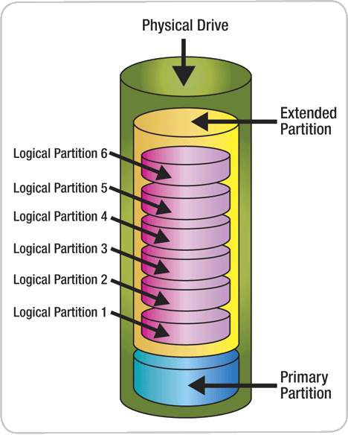
Disk partitioning

Slide 100
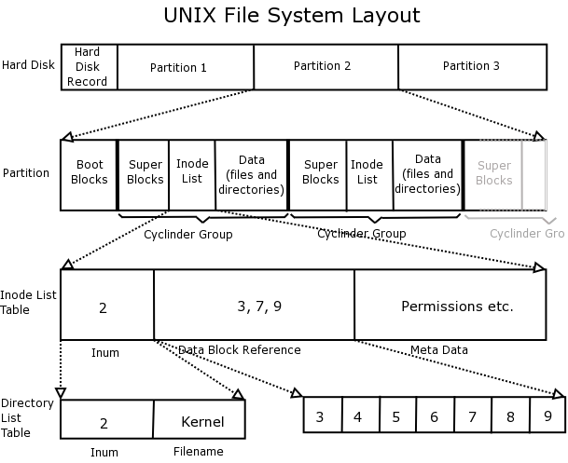
Disk layout

Slide 101
fdisk manipulate disk partition table
mkfs build a Linux filesystem
mkfs.ext4
mkfs.xfs
mount mount a filesystem

Slide 102
RAID

Slide 103
What is RAID?
RAID – Redundant Array of Independent Disks

Slide 104
Motivation for RAID
Just as additional memory in form of cache, can improve system performance, in the same way additional disks can also improve system performance
In RAID, we use an array of disks. These disks operate independently
Since there are many disks, multiple I/O requests can be handled in parallel if the data required is on separate disks
A single I/O operation can be handled in parallel if the data required is distributed across multiple disks

Slide 105
Benefits of RAID
Data loss can be very dangerous for an organisation
RAID technology prevents data loss due to disk failure
RAID technology can be implemented in hardware or software
Servers make use of RAID technology

Slide 106
RAID Technology
There are 7 levels RAID schemes. These are called RAID 0, RAID 1, … RAID 6
The common characteristic in all these levels is:
A set of physical disk drives.
The operating system views these separate disks as a single logical disk.
Data is distributed across the physical drives of the array.
Redundant disk capacity is used to store parity information.
Parity information can help in recovering data in case of disk failure

Slide 107
RAID Level 0 - Characteristics
RAID level 0 divides data into block units and writes them across a number of disks.
As data is placed across multiple disks, it is also called “data stripping”
The advantage of distributing data over disks is that if two different I/O requests are pending for two different blocks of data, then there is a possibility that the requested blocks are on different disks

Slide 108
RAID Level 0
There is no parity checking of data.
So if data in one drive gets corrupted then all the data would be lost. Thus RAID 0 does not support data recovery
Spanning is another term that is used with RAID level 0 because the logical disk will span all the physical drives
RAID 0 implementation requires minimum 2 disks

Slide 109
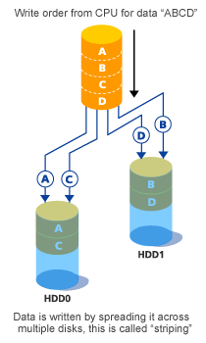
RAID Level 0 - Diagram

Slide 110
RAID Level 0 - Advantages
Advantage of RAID level 0 is that it increases speed.
Throughput (speed) is increased because :
Multiple data requests probably not on same disk
Disks seek in parallel
A set of data is likely to be striped across multiple disks
Implementation is easy
No overhead of parity calculation

Slide 111
RAID Level 0 - Disadvantages
Not a true RAID because it is not fault tolerant
The failure of just one drive will result in all data in an array being lost. Implementation is easy
Should not be used in mission critical environments

Slide 112
RAID Level 1 - Characteristics
This level is called "mirroring" as it copies data onto two disk drives simultaneously.
As same data is placed on multiple disks, it is also called “data mirroring”
The automatic duplication of the data means there is little likelihood of data loss or system downtime.

Slide 113
RAID Level 1
Data stripping is used as in RAID 0, but each logical strip is mapped to two separate physical drives
Thus every disk in the array has a mirror disk that contains the same data
Data can be read from either disk but is written on both disks

Slide 114
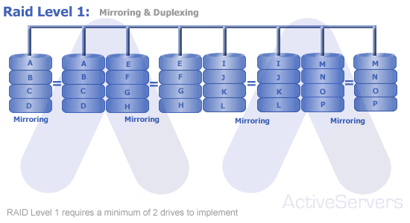
RAID Level 1 - Diagram

Slide 115
RAID Level 1 - Animaton

Slide 116
RAID Level 1 - Characteristics
A read request can be executed by either of the two disks
A write request means that both the disks must be updated. This can be done in parallel
There is no overhead of storing parity information
Recovery from failure is simple. If one drive fails we just have to access data from the second drive

Slide 117
RAID Level 1 - Advantages
Main advantage is RAID 1 provides fault tolerance. If one disk fails, the other automatically takes over.
So continuous operation is maintained.
RAID 1 is used to store systems software (such as drivers, operating systems, compilers, etc) and other highly critical files.

Slide 118
RAID Level 1 - Disadvantages
Main disadvantage is cost. Since data is duplicated, storage costs increase.

Slide 119
RAID Level 2
In RAID 2 mechanism, all disks participate in the execution of every I/O request.
The spindles of individual disk drives are synchronized so that each disk head is in the same position on each disk at any given time.
Data stripping is used.
Error correcting code is also calculated and stored with data
Not implemented in practice due to high costs and overheads

Slide 120
RAID Level 3
Data is divided into byte units and written across multiple disk drives.
Parity information is stored for each disk section and written to a dedicated parity drive.
All disks can be accessed in parallel
Data can be transferred in bulk. Thus high speed data transmission is possible

Slide 121
RAID Level 3
In case of drive failure, the parity drive is accessed and data is reconstructed from the remaining devices.
Once the failed drive is replaced, the missing data can be restored on the new drive
RAID 3 can provide very high data transfer rates

Slide 122
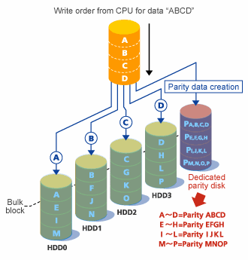
RAID Level 3

Slide 123
RAID Level 3
Parity Disk

Slide 124
Important Questions on RAID
What is the motivation for using RAID? What common characteristics are shared by all RAID levels?
Explain RAID level 0, 1, 2, and 3.
Explain the term striped data.
How is redundancy achieved in a RAID system?

Slide 125
LVM
Logical Volume Manager

Slide 126
What is Logical Volume Management?
Software that allows the user to edit the storage configuration without manipulating the actual hardware and vice versa.

Slide 127
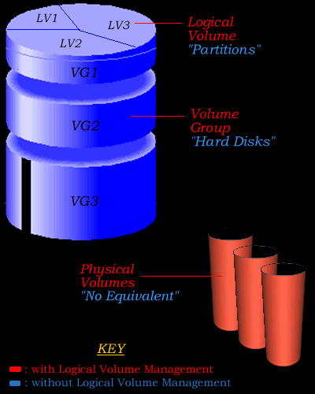
How Does LVM Work?
The LVM hides information about where information is stored, on which hardware, and where exactly on that hardware from the entire Operating System allowing it to manipulate the configuration of the storage capacities.

Slide 128
Configuring LVMs
3 set-up steps for LVM
Define & Initialize Physical Volumes planning to use
Define Volume Groups planning to group PVs together
Set up Logical Volumes on each VG

Slide 129
Configuring LVMs
pvcreate /dev/device [/dev/device]
pvcreate command initializes a physical device as a physical volume.
vgcreate vg-name /dev/device [dev/device]
vgcreate command creates a volume group with all the physical volumes specified.
lvcreate –L size –n lv-name vg-name
lvcreate command creates a logical volume on the volume group vg-name.

Slide 130
Extending Volume without losing data
First you create your physical volumes by the following command:
pvcreate /dev/device1
Then you extend your volume groups using this command:
vgextend vg-name /dev/device1

Slide 131
Shrinking Volume without losing data
Removing a physical volume is just as simple by using the following command:
vgreduce vg-name /dev/device

Slide 132
Advantages
LVM has the capacity to manage extremely large data sets
PVs can be added, VG’s and VL’s can be extended while file systems are still mounted and in use

Slide 133
Package Management

Slide 134
Package management
rpm RPM Package Manager
Download and install the rpms using rpm command.
Dependencies should be installed manually which is tedious.
yum yum is an interactive, rpm based, package manager
Advanced package manager
Resolves the dependencies automatically
Can make use of any 3rd party repos for software installation

Slide 135
RPM
rpm -i Install the package
rpm -i package-xx.xx.xx.rpm
rpm –ivh Installs the package and displays the status with hashes
rpm -ivh package-xx.xx.xx.rpm
rpm -Uvh Upgrades the existing package
rpm –e Removes the package

Slide 136
RPM
rpm –qa List all the installed packages
rpm –q <pkg name> Shows the package name if installed
rpm –qi <pkg name> Displays the information about the package
rpm –ql <pkg name> List the files installed as part of the package
rpm –qf <file path> Show the package name which contains the given file
rpm –qV <pkg name> Displays the integrity of the package

Slide 137
YUM
yum search <pattern> Displays the available with the given pattern
yum info <pkg name> Displays the package information
yum install <pkg name> Download and install the package from the installed repos
yum repolist Displays the list of repos currently active on the system
yum upgrade <pkg name> Upgrades the installed package
yum erase <pkg name> Uninstall package

Slide 138
Compile software
Download $ lynx http://httpd.apache.org/download.cgi
Extract $ gzip -d httpd-NN.tar.gz
$ tar xvf httpd-NN.tar
$ cd httpd-NN
Configure $ ./configure --prefix=PREFIX
Compile $ make
Install $ make install
Customize $ vi PREFIX/conf/httpd.conf
Test $ PREFIX/bin/apachectl -k start

Slide 139
Service management

Slide 140
Service management
Centos 6
service <service name> [stop|start|restart]
chkconfig <service name> [on|off]
Centos 7
systemctl [stop|start|restart] <service name>
systemctl [enable|disable] <service name>

